Slide 1
Occupancy Rate Analysis
Methodology and Results

Slide 2
Introduction
Occupancy Rate Definition: Booked days for a property in a selected time period / Total days in the selected time period
Area-wide Calculation: Each property given equal weightage
Purpose: To analyze monthly occupancy patterns across properties

Slide 3
Data Sources
Property Booking Performance
Property ID
Year and month
Monthly occupancy rate
2. Property Profile
Property ID
Property demographics

Slide 4
Key Assumptions
Each property has equal weightage in calculations
All properties are functional every day of each month
Missing data is treated as zero occupancy

Slide 5
Calculation Methodology
Formula for Area-wide Monthly Occupancy:
Monthly Occupancy Rate = Sum of all property occupancy rates / Total number of properties
Example:
Selected period: One month
Total properties in area: 11,000
Available occupancy data: 3,000 properties
Remaining 8,000 properties: Assumed 0% occupancy

Slide 6
Implementation Process
Merge property profile with performance data
Identify properties with missing occupancy data
Add records for all missing property-month combinations with 0% occupancy
Calculate average occupancy by month across all properties
Analyze monthly trends in occupancy rates

Slide 7
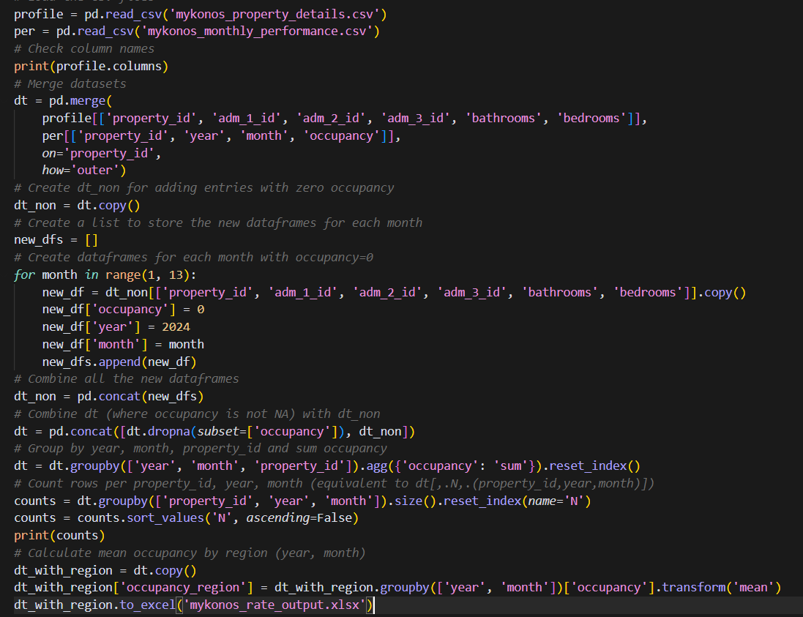
Code Implementation

Slide 8
Visual Representation of Results

Slide 9
Key Insights
Seasonality Pattern: Clear peak season during summer months (June-August)
Highest Occupancy: August (24.5%)
Lowest Occupancy: December (1.9%)
Shoulder Seasons: Spring (March-May) and Fall (September-October)
Off-Season: Winter months (November-February)

Slide 10
Implications & Applications
Staffing Optimization: Adjust staffing levels to match occupancy patterns
Inventory Management: Plan supplies and amenities according to expected guest volume
Promotional Campaigns: Create targeted offers for low-occupancy periods
Budget Allocation: Distribute marketing and operational budgets seasonally
Performance Benchmarking: Compare property performance against regional averages
Investment Planning: Guide decisions on property acquisitions based on occupancy patterns
Guest Experience: Focus on service enhancements during peak periods
Energy Management: Optimize utility usage based on occupancy forecasts
Market Segmentation: Target different customer segments during various seasons
Competitive Analysis: Compare seasonal performance against competitors

Slide 11
Other Observations/Doubts
In the excel the total properties are taken as maximum occupied property in a month
While it should be all the available properties in the selected month/year
ADR is for one property or for 1 bedroom in one property?
There is no point to calculate adjusted revenue for a single category
Gives no real insights, no meaning
Current Revenue formula is = (# of Bed) X (# of Days) X ADR
Formula should be = (# of Bed) X (# of Days) X ADR X (# of Properties)

Slide 13
Thank You

